Slide 1
Foundation of Mathematics II
Dr. Arbah Sultan

Slide 2
Some Types of Functions
1.Inverse Function and Its Properties
We start this section by restate some basic and useful concepts.
Definition 1.1.1. (Inverse of a Relation)
Suppose $R⊆A×B$ is a relation between $A$ and $B$ then the inverse relation $R^{−1}⊆B×$ A is defined as the relation between $B$ and $A$ and is given by
$bR^{−1}a$ if and only if $aRb$.
That is$,R^{−1}=\{(b, a) ∈ B ×A : (a, b) ∈ R\}.$
Definition 1.1.2. (Function)
(i) A relation $f$ from $A$ to $B$ is said to be function iff
$∀x∈A$ $∃!y∈B$ such that $(x,y)∈f$
(ii) A relation $f$ from $A$ to $B$ is said to be function iff
$∀x∈A$ $∀y,z∈B$, if $\left(x,y\right)∈f ⋀ (x,z)∈f$, then $y=z$.
(iii) A relation $f$ from $A$ to $B$ is said to be function iff
$(x_{1},y_{1})$ and $(x_{2},y_{2})$ $∈f$ such that if $x_{1}=x_{2}$, then $y_{1}=y_{2}$.
This property called the well-defined relation.

Slide 3
Notation 1.1.3. We write $f (a)=b$ when $(a, b)∈f$ where $f$ is a function. We say that $b$ is the image of $a$ under$f$, and $a$ is a preimage of $b$.
Question 1.1.4. It is clear from Definition 1.1 and 1.2 that if $f : X → Y$ is a function, does $f^{−1}: Y → X$ exist? If Yes, does $f^{−1}: Y → X$ is a function?
Example 1.1.5.
(i) Let $A=\{1,2,3\}$, $B=\{a,b\}$ and $f_{1}$ be a function from $A$ to $B$ defined bellow. $f_{1}=\{\left(1,a\right),\left(2,a\right),\left(3,b\right)\}$. Then ${f_{1}}^{−1}$ is ------------------------ .
(ii) Let $A=\{1,2,3\}$, $B=\{a,b,c,d\}$ and $f_{2}$ be a function from $A$ to $B$ defined bellow. $f_{2}=\{\left(1,a\right),\left(2,b\right),\left(3,d\right)\}$. Then ${f_{2}}^{−1}$ is ------------------------ .
(iii) Let $A=\{1,2,3\}$, $B=\{a,b,c,d\}$ and $f_{3}$ be a function from $A$ to $B$ defined bellow. $f_{3}=\{\left(1,a\right),\left(2,b\right),\left(3,a\right)\}$. Then ${f_{3}}^{−1}$is ------------------------ .
(iv) Let $A=\{1,2,3\}$, $B=\{a,b,c,\}$ and $f_{4}$ be a function from $A$ to $B$ defined bellow. $f_{4}=\{\left(1,a\right),\left(2,b\right),\left(3,c\right)\}$. Then ${f_{4}}^{−1}$ is ------------------------ .
(v) Let $A=\{1,2,3\}$, $B=\{a,b,c,\}$ and $f_{5}$ be a relation from $A$ to $B$ defined bellow. $f_{5}=\{\left(1,a\right),\left(1,b\right),\left(3,c\right)\}$. Then $f_{5}$ is -------------------- and ${f_{5}}^{−1}$ is ----------------- .
Definition 1.1.6. (Inverse Function)
The function $f:X →Y$ is said to be has inverse if the inverse relation $f^{−1}: Y →X$ is function.

Slide 4
Example 1.1.7.
(i) $f : ℝ →ℝ$, $f\left(x\right)=x+3$, that is,
$$f=\{\left(x,y\right)∈ℝ×ℝ:y=x+3\}$$
$f=\{\left(x,x+3\right)∈ℝ×ℝ\}$.
Then
$$f^{−1}=\{\left(x,y\right)∈ℝ×ℝ:\left(y,x\right)∈f\}$$
$$f^{−1}=\{\left(x,y\right)∈ℝ×ℝ: x=y+3\}$$
$$f^{−1}=\{\left(x,y\right)∈ℝ×ℝ: y=x−3\}$$
$f^{−1}=\{\left(x,x−3\right)∈ℝ×ℝ\}$, that is $f^{−1}\left(x\right)=x−3$.
$f^{−1}$ is function as shown below.
Let $(y_{1},f^{−1}(y_{1}))$ and $(y_{2},f^{−1}(y_{2}))$ $∈f^{−1}$ such that $y_{1}=y_{2}$, T. P. $f^{−1}\left(y_{1}\right)=f^{−1}(y_{2})$.
Since $y_{1}=y_{2}$, then $y_{1}−3=y_{2}−3$ (By add $−3$ to both sides)
$⟹f^{−1}\left(y_{1}\right)=f^{−1}(y_{2})$.

Slide 5
(ii) $g : ℝ →ℝ$, $f\left(x\right)=x^{2}$, that is,
$$g=\{\left(x,y\right)∈ℝ×ℝ:y=x^{2}\}$$
$g=\{\left(x,x^{2}\right)∈ℝ×ℝ\}$.
Then
$$g^{−1}=\{\left(x,y\right)∈ℝ×ℝ:\left(y,x\right)∈g\}$$
$$g^{−1}=\{\left(x,y\right)∈ℝ×ℝ: x=y^{2}\}$$
$g^{−1}=\{\left(x,y\right)∈ℝ×ℝ: y=±\sqrt{x}\}$
$g^{−1}=\left\{\left(x,±\sqrt{x}\right)∈ℝ×ℝ\right\}$, that is $g^{−1}\left(x\right)=±\sqrt{x}$.
$g^{−1}$ is not function since $g^{−1}\left(4\right)=±2$.
Theorem 1.1.8. Let $f : A → B$ be a function. Then $f$is bijective iff the inverse relation $f^{−1}$is a function from $B$ to $A$.
Proof.
Suppose $f : A → B$ is bijective. To prove $f^{−1}$is a function from $B$ to $A$.
$f^{−1}≠∅$ since $f$ is onto.
($∗$) Let $(y_{1},x_{1})$ and $(y_{2},x_{2})$ $∈f^{−1}$ such that $y_{1}=y_{2}$, to prove $x_{1}=x_{2}$.
$(x_{1},y_{1})$ and $(x_{2},y_{2})$ $∈f$ Def. of $f^{−1}$
$(x_{1},y_{1})$ and $(x_{2},y_{1})$ $∈f$ By hypothesis ($∗$)
$x_{1}=x_{2}$ Def. of 1-1 on $f$
$∴$ $f^{−1}$is a function from $B$ to $A$.

Slide 6
Conversely, suppose $f^{−1}$is a function from $B$ to $A$, to prove $f : A → B$is bijective, that is, 1-1 and onto.
1-1: Let $a,b∈X$ and $f\left(a\right)=f(b)$. To prove $a=b$.
$(a,f(a))$ and $(b,f\left(b\right))$ $∈f$ Hypothesis ($f$is function)
$(a,f(a))$ and $(b,f\left(a\right))$ $∈f$ Hypothesis ($f\left(a\right)=f(b)$)
$(f\left(a\right),a)$ and $(f\left(a\right),b)$ $∈f^{−1}$ Def. of inverse relation $f^{−1}$
$a=b$ Since $f^{−1}$ is function
$∴$ $f$ is 1-1.
onto: Let $b∈Y$. To prove $∃a∈A$ such that $f\left(a\right)=b$.
$(b,f^{−1}(b))∈f^{−1}$ Hypothesis ( $f^{−1}$is a function from $B$ to $A$)
$(f^{−1}\left(b\right),b)∈f$ Def. of inverse relation $f^{−1}$
Put ${a=f}^{−1}\left(b\right)$.
$a∈A$ and $f\left(a\right)=b$ Hypothesis ( $f$ is function)
$∴$ $f$ is onto.

Slide 7
Definition 1.1.9. Let $f : X → Y$ be a function and $A⊆X$ and $B⊆y$.
(i) The set $f\left(A\right)=\{f(x)∈Y:x∈A\}=\{y∈Y:∃x∈A such that y=f(x)\}$ is called the direct image of $A$ by $f$.
(ii) The set $f^{−1}\left(B\right)=\{x∈X:f(x)∈B\}$ is called the inverse image of $B$ with respect to $f$.
Example 1.1.10.
(i) Let $f:ℝ→ℝ$, $f\left(x\right)=x^{4}−1$. $f^{−1}\left(15\right)=\left\{x∈ℝ:x^{4}−1=15\right\}$
$=\left\{x∈ℝ:x^{4}=16\right\}=\left\{−2,2\right\}.$
(ii) Let $f:ℝ→ℝ$, $f\left(x\right)=\left\{\begin{matrix}−1, & −1≤x<0 \\ 0, & 0≤x<1 \\ \begin{matrix}1, \\ 2,\end{matrix} & \begin{matrix}1≤x<2 \\ 2≤x<3\end{matrix}\end{matrix}\right.$. $D\left(f\right)=\left[−1,3\right), R\left(f\right)=\{−1,0,1,2\}$.
$f\left(\left[−1,−1/2\right]\right)=−1$. $f\left(\left[−1,0\right]\right)=\{−1,0\}$.
$f^{−1}\left(0\right)=[0,1)$. $f^{−1}\left([1,3/{2]}\right)=[1,2)$.

Slide 8
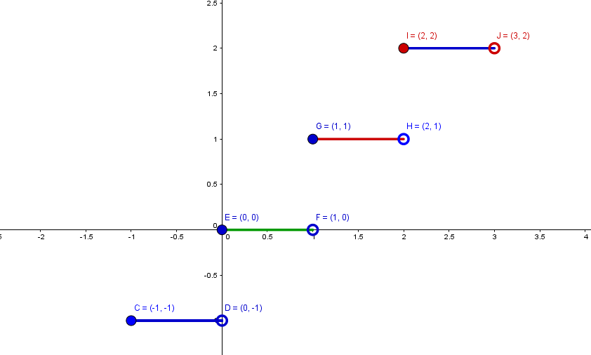

Slide 9
Definition 1.1.11.
(i) A function $I_{A} : A → A$ defined by $I_{A}\left(x\right)=x$, for every $x∈A$ is called the identity function on $A$. $I_{A}=\{\left(x,x\right):x∈A\}$.
(ii) Let $A⊆X$. A function $i_{A} : A → X$ defined by $i_{A}\left(x\right)=x$, for every $x∈A$ is called the inclusion function on $A$.
Theorem 1.1.12.
If $f : X → Y$ is a bijective function, then ${f∘f}^{−1}=I_{Y}$ and $f^{−1}∘f=I_{X}$.
Proof. Exercise.
Example 1.1.13. Let $f:ℤ×ℤ→ℤ×ℤ$ be a function defined as
$$f\left(m,n\right)=\left(m+n,m+2n\right).$$
$f$ is bijective(Exercise).
To find the inverse $f^{−1}$ formula, let $f\left(n,m\right)=(x,y)$. Then
$\left(m+n,m+2n\right)=(x,y)$. So, the we get the following system

Slide 10
$$\begin{matrix}m+n & = & x….(1) \\ m+2n & = & y….(2)\end{matrix}$$
From (1) we get $m=x−n$ $….(3)$
$n=y−x$ Inf (2) and (3) $….(4)$
$m=2x−y$ Rep ($n: y−x$) or sub(4) in (3)
Define $f^{−1}$ as follows
$f^{−1}\left(x,y\right)=(2x−y,y−x)$.
We can check our work by confirming that ${f∘f}^{−1}=i_{Y}$.
$${(f∘f}^{−1})\left(x,y\right)=f\left(2x−y,y−x\right)$$
$=(\left(2x−y\right)+\left(y−x\right),\left(2x−y\right)+2(y−x))$
$=\left(x,2x−y+2y−2x\right)=\left(x,y\right)=i_{Y}(x,y)$
Remark 1.1.14. If $f : X → Y$ is oneto-one but not onto, then one can still define an inverse function ${f }^{−1} : R(f) → X$ whose domain in the range of $f$.

Slide 11
Theorem 1.1.15. Let $f : X → Y$be a function.
(i) $If \{Y_{j} ⊂ Y : j ∈J\}$ is a collection of subsets of $Y$, then
$f^{−1}(\bigcup_{j∈J}{Y_{j}}$) =$\bigcup_{j∈J}{f^{−1}}$($Y_{j})$ and $f^{−1}\left(\bigcap_{j∈J}{Y_{j}}\right)=\bigcap_{j∈J}{f^{−1}(Y_{j})}$
(ii) If $\{X_{i}⊂X:i∈I\}$ is a collection of subsets of $X$, then
$f( \bigcup_{i∈I}{X_{i}}$) =$\bigcup_{i∈I}{f(X_{i})}$ and $f(\bigcap_{i∈I}{X_{i})⊆\bigcap_{i∈I}{f(X_{i})}}$.
(iii) If $A$ and $B$ are subsets of $X$ such that $A=B$, then $f\left(A\right)=f(B)$. Then converse is not true.
(iv) If $C$ and $D$ are subsets of $Y$ such that $C=D$, then $f^{−1}\left(C\right)=f^{−1}(D)$. Then converse is not true.
(v) If $A$ and $B$ are subsets of $X$, then $f\left(A\right)−f(B)⊆f(A−B)$. The converse is not true.
(vi) If $C$ and $D$ are subsets of $Y$, then $f^{−1}\left(C\right)−f^{−1}\left(D\right)=f^{−1}(C−D)$.
Proof:
(i) Let ${x∈f}^{−1}(\bigcup_{j∈J}{Y_{j}}$).
$∃y∈\bigcup_{j∈J}{Y_{j}}$ such that $f\left(x\right)=y$ Def. of inverse relation $f^{−1}$
$y∈Y_{j}$ for some $j∈J$ Def. of $⋃$
$x∈f^{−1}(Y_{j})$ Def. of inverse $f^{−1}$
so $x∈\bigcup_{j∈J}{f^{−1}}$($Y_{j})$ Def. of $⋃$
It follow that $f^{−1}(\bigcup_{j∈J}{Y_{j}}$) $⊆\bigcup_{j∈J}{f^{−1}}$($Y_{j})$ Def. of $⊆$ $…..(∗)$

Slide 12
Conversely, If $x∈\bigcup_{j∈J}{f^{−1}}$($Y_{j})$, then $x∈f^{−1}(Y_{j})$, for some $j∈J$ Def. of $⋃$
So $f(x)∈Y_{j}$ and $f\left(x\right)∈\bigcup_{j∈J}{Y_{j}}$ Def. of inverse and $⋃$
$x∈f^{−1}(\bigcup_{j∈J}{Y_{j})}$ Def. of inverse $f^{−1}$
It follow that $\bigcup_{j∈J}{f^{−1}}$($Y_{j})⊆$ $f^{−1}(\bigcup_{j∈J}{Y_{j}}$) Def. of $⊆$ $…..(∗∗)$
$f^{−1}(\bigcup_{j∈J}{Y_{j}}$) $=\bigcup_{j∈J}{f^{−1}}$($Y_{j})$ From $\left(∗\right),(∗∗)$ and Def. of $=$
Example 1.1.16. Let $f:ℤ⟶ℤ$ be a function defined as $f\left(x\right)=1$.
$ℤ_{e}⋂ℤ_{o}=∅$. $f\left(ℤ_{e}⋂ℤ_{o}\right)=f\left(∅\right)=∅$. But $f(ℤ_{e})⋂{f(ℤ}_{o})=\{1\}.$
2.Types of Function
Definitions 1.2.1.
(i) (Constant Function)
The function $f:X⟶Y$ is said to be constant function if there exist a unique element $b∈Y$ such that $f\left(x\right)=b$ for all $x∈X$.

Slide 13
(ii) (Restriction Function)
Let $f:X⟶Y$ be a function and $A⊆X$. Then the function $g:A⟶Y$ defined by $g\left(x\right)=f(x)$ all $x∈X$ is said to be restriction function of $f$and denoted by $g={\left.f\right|}_{A}$.
(iii) (Extension Function)
Let $f:A⟶B$ be a function and $A⊆X$. Then the function $g:X⟶B$ defined by $g\left(x\right)=f(x)$ all $x∈A$ is said to be extension function of $f$ from $A$ to $X$.
(iv) (Absolute Value Function )
The function $f:ℝ⟶ℝ$ which defined as follows
$$f\left(x\right)=|x|=\left\{\begin{matrix}x, & x≥0 \\ −x & x<0\end{matrix}\right.$$
is called the absolute value function.
(v) (Permutation Function)
Every bijection function $f$ on a non empty set $A$ is said to be permutation on $A$.
(vi) (Sequence)
Let $A$ be a non empty set. A function $f:ℕ⟶A$ is called a sequence in $A$ and denoted by $\{f_{n}\}$, where $f_{n}=f(n)$.
(vii) (Canonical Function)
Let $A$ be a non empty set, $R$ an equivalence relation on $A$ and $A/R$ be the set of all equivalence class. The function $π:A⟶A/R$ defined by $π\left(x\right)=[x]$ is called the canonical function.

Slide 14
(viii) (Projection Function)
Let $A_{1}$, $A_{2}$ be two sets. The function $P_{1}:A_{1}×A_{2}⟶A_{1}$ defined by $P_{1}\left(x,y\right)=x$ for all ${\left(x,y\right)∈A}_{1}×A_{2}$ is called the first projection.
The function $P_{2}:A_{1}×A_{2}⟶A_{2}$ defined by $P_{2}\left(x,y\right)=y$ for all ${\left(x,y\right)∈A}_{1}×A_{2}$ is called the second projection.
(ix) (Cross Product of Functions)
Let ${f:A_{1}⟶A}_{2}$ and ${g:B_{1}⟶B}_{2}$ be two functions. The cross product of $f$ with $g$, $f×g:A_{1}×B_{1}⟶A_{2}×B_{2}$ is the function defined as follows:
$\left(f×g\right)\left(x,y\right)=(f\left(x\right),g(y))$ for all ${\left(x,y\right)∈A}_{1}×B_{1}$.
Examples 1.2.2.
(i)(Constant Function). $f:ℝ⟶ℝ$, $f\left(x\right)=2, ∀x∈ℝ$. $D\left(f\right)=ℝ$, $R\left(f\right)=\{1\}$, $Cod\left(f\right)=ℝ$.

Slide 15
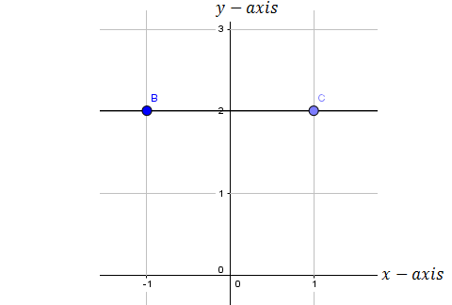

Slide 16
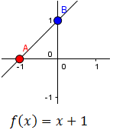
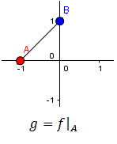
(ii) (Restriction Function). $f:ℝ⟶ℝ$, $f\left(x\right)=x+1, ∀x∈ℝ$.
$D\left(f\right)=ℝ$, $R\left(f\right)=ℝ$, $Cod\left(f\right)=ℝ$. Let $A=[−1,0]$.
$g={\left.f\right|}_{A}:A⟶ℝ$. $g\left(x\right)=f\left(x\right)=x+1, ∀x∈A.$
$D\left(g\right)=A$, $R\left(f\right)=[−1,1]$, $Cod\left(f\right)=ℝ$.

Slide 17
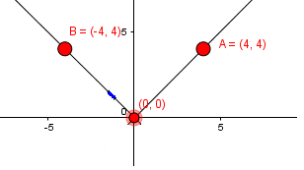
(iii) (Extension Function). $f:[−1,0]⟶ℝ$, $f\left(x\right)=x+1, ∀x∈[−1,0]$.
$D\left(f\right)=[−1,0]$, $R\left(f\right)=[−1,1]$, $Cod\left(f\right)=ℝ$.
Let $A=ℝ$. $g:A⟶ℝ$. $g\left(x\right)=f\left(x\right)=x+1, ∀x∈A.$
$D\left(g\right)=A$, $R\left(g\right)=ℝ$, $Cod\left(g\right)=ℝ$.
(iv) (Absolute Value Function )$f:ℝ⟶ℝ$, $f\left(x\right)=|x|=\left\{\begin{matrix}x, & x≥0 \\ −x & x<0\end{matrix}\right.$.
$D\left(f\right)=ℝ$, , $R\left(f\right)=[0,∞)$, $Cod\left(f\right)=ℝ$.

Slide 18
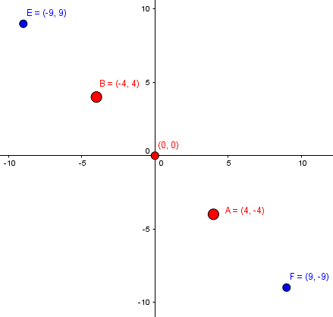
(v) (Permutation Function). $f:ℕ⟶ℕ$, $f\left(x\right)=−x, ∀x∈ℕ$. The function is bijective, so it is permutation function. $D\left(f\right)=ℕ$, , $R\left(f\right)=ℕ$, $Cod\left(f\right)=ℕ$.

Slide 19
(vi) (Sequence).$f:ℕ⟶ℚ$, $f\left(n\right)=\frac{1}{n}$ , $∀x∈ℕ$. $\left\{f_{n}\right\}=\{\frac{1}{n} \}_{n=1}^{∞}$.
(vii) (Canonical Function). Let $R$ be an equivalence relation defined on $ℤ$ as follows:
$xRy$ iff $x−y$ is even integer, that is, $R=\{\left(x,y\right)∈ℤ×ℤ:x−y even\}$.
$\left[0\right]=\left\{x∈ℤ:x−0 even\right\}=\left\{…,−4,−2,0,2,4,…\right\}=\left[2\right]=\left[−2\right]=…$.
$\left[1\right]=\left\{x∈ℤ:x−1 even\right\}=\left\{…,−5,−3,−1,1,3,5,…\right\}=\left[−1\right]=[3]=…$.
$ℤ/R=\{\left[0\right],[1]\}$.
$$π\left(0\right)=\left[0\right]=π\left(2\right)=π\left(−2\right)=….$$
$$π\left(1\right)=[1]=π\left(−1\right)=π\left(−3\right)=….$$
(viii) (Projection Function)
$P_{1}:ℤ×ℚ⟶ℤ$, $P_{1}\left(x,y\right)=x$ for all $\left(x,y\right)∈ℤ×ℚ$. $P_{1}\left(2,\frac{2}{5}\right)=2$.$P_{1}\left(ℤ,\frac{2}{5}\right)=ℤ$
. ${P_{1}}^{−1}\left(3\right)=\{3\}×ℚ$.

Slide 20
(ix) (Cross Product of Functions)
$f:ℕ⟶ℚ$, $f\left(n\right)=\frac{1}{n}, ∀n∈ℕ$ and $f:ℕ⟶ℕ$, $f\left(x\right)=−x, ∀x∈ℕ$
$f×g:ℕ×ℕ⟶ℚ×ℕ$, $\left(f×g\right)\left(x,y\right)=(f\left(x\right),g(y))$
$=(\frac{1}{x},−y)$ for all $\left(x,y\right)∈ℕ×ℕ$.

